Slide 1
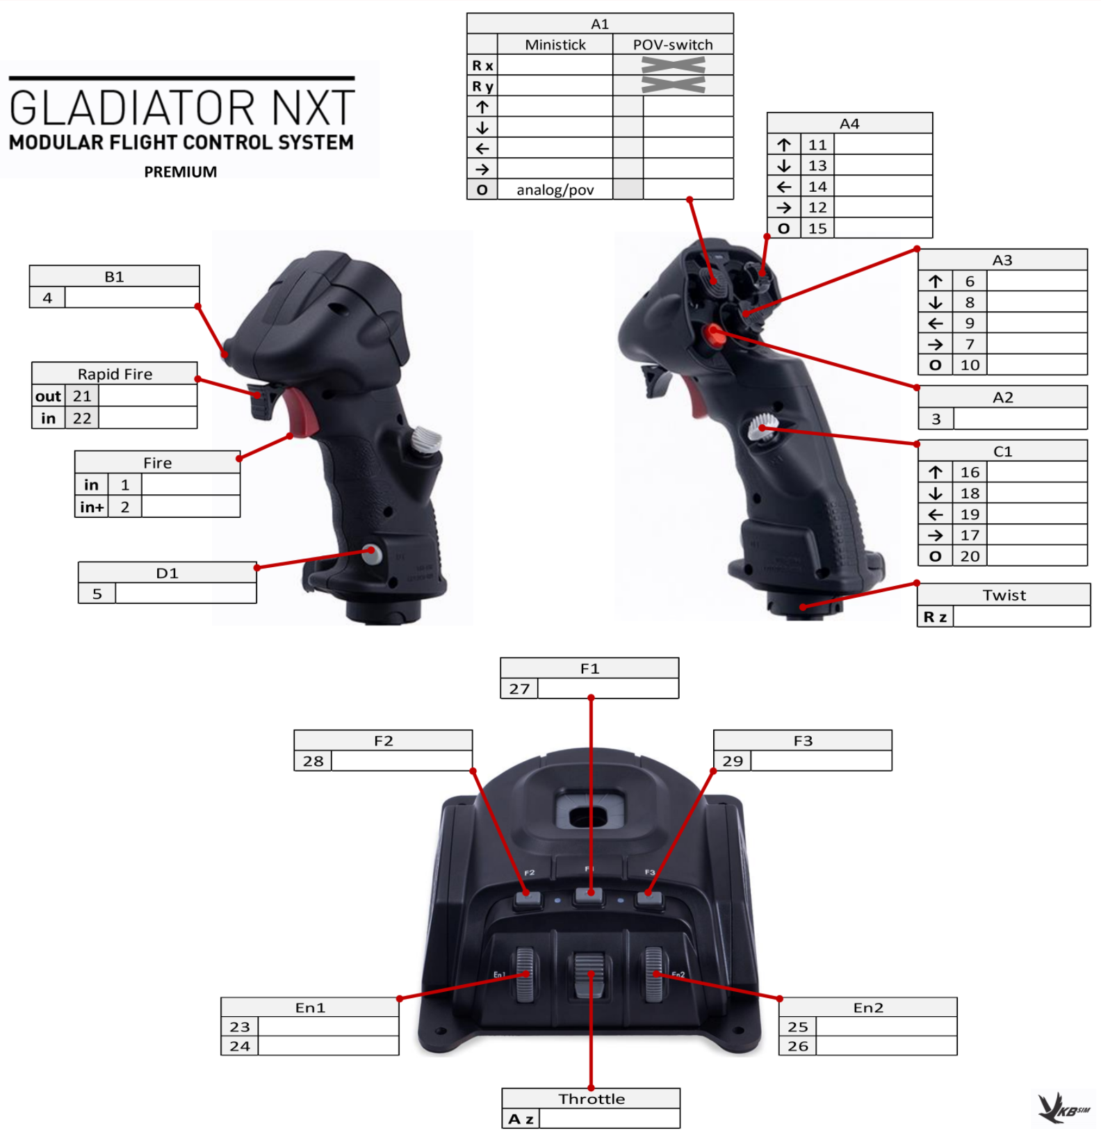
Cockpit View Yaw Axis (Reversed)
External View Yaw Axis
Cockpit View Pitch Axis
External View Pitch Axis (Reversed)
Reset Cockpit View
Rudder Trim Left
Rudder Trim Right
Toggle Rudder Trim
Cockpit/External
View Mode
Elevator Trim Up
Elevator Trim Down
Aileron Trim Left
Aileron Trim Right
Toggle Elevator Trim
Toggle Active
Pause
Toggle Autopilot Wing Leveler
Brakes
Toggle Parking
Brakes
Rudder Axis
Toggle Disengage
Autopilot
Toggle Landing
Gear
Toggle Lights
Stick
Lx / Ax (Lean Stick Left/Right) | Ailerons Axis
Ly / Ay (Lean Stick Forward/Backward) | Elevator Axis
Retract Spoilers
Extend Spoilers
Lz /
Flaps Axis (-100 to 100%) (Reversed)

